Slide 1

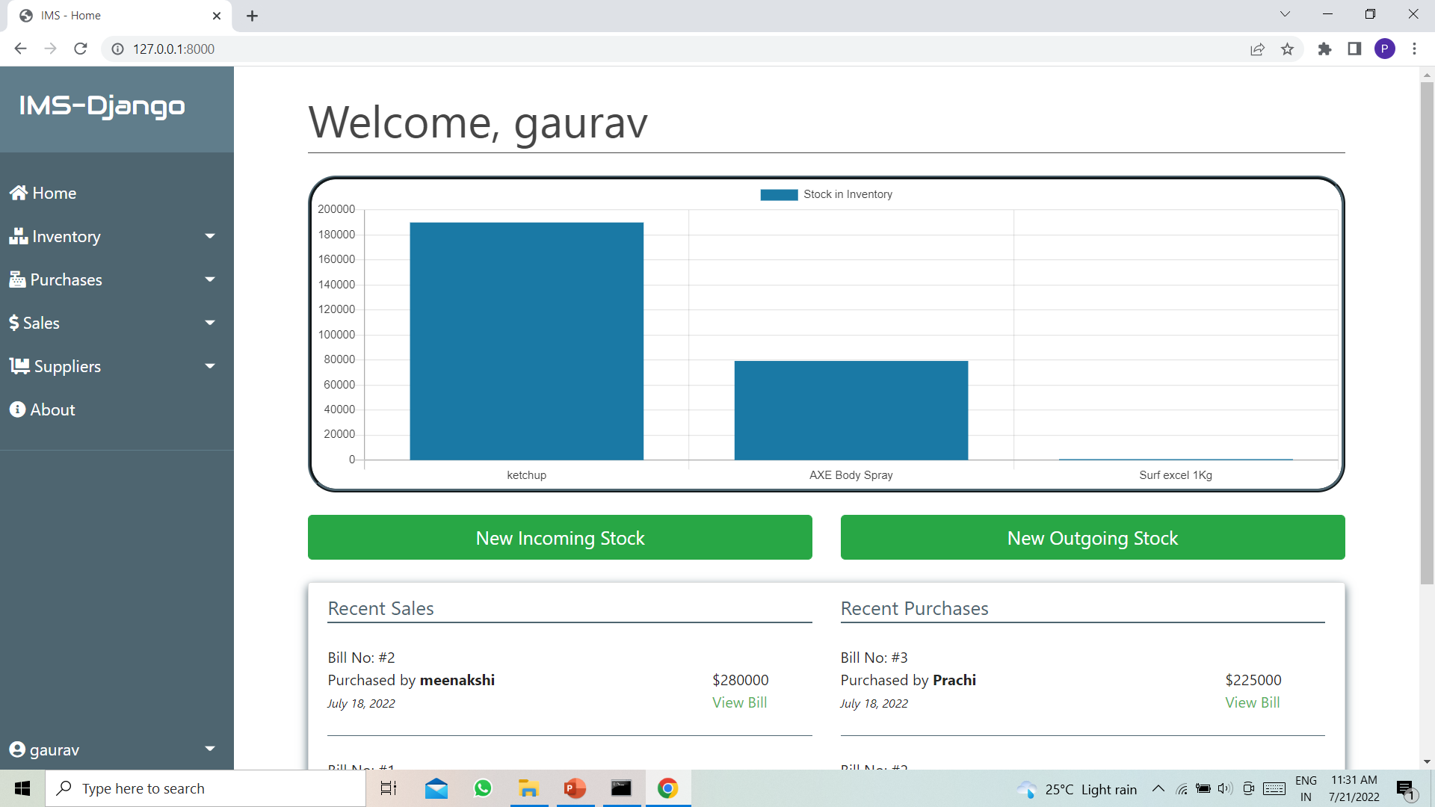
Presented by: Guided BY: Praveen Kumar Gaurav Proff. Swati Patel Ma’am (215160694008) Prachi Sharma (215160694002) Meenakshi Devi (215160694025)
Inventory Management system

Slide 2
Outline
Introduction
Technology
Team Work
Available Feature
Step to Install
Project Screen shot
Flow and Module
Future Implementation
Bibliography

Slide 3
Introduction
A fully functional project based on Inventory Management System which uses Python with Django Web Framework.
We can Add the supplier and product manually
Taking stocks at Supplier Prices
Selling Stocks at own Prices
Proper stock management according to their availability

Slide 4
PROJECT DEFINITION
A fully functional project based on Inventory Management System which uses Python with Django Web Framework.
INVENTORY MANAGEMENT SYSTEM
Manages the Stocks
Generates bills.
inward entry
Outward entry in Inventory Management System software

Slide 5
Project Technology
Django version 3.0.7
Sqlite3
Html 5
CSS
JavaScript
Ajax
Bootstrap 5

Slide 6
Team Work
As we Know Django Work On MVT(Model Views Template):
Praveen Kumar Gaurav Model
Meenakshi Devi Views
Prachi Sharma Templates

Slide 7
Available Feature
Admin Panel
Manage Inventory
Search Stocks
Sales Management
Purchase Management
Invoice Bill
Additional Tax Details
Print bill
Delete and Update Bill
Manage Suppliers
Supplier Profile
View Recent Sales and Purchase

Slide 8
Step To Install the Software
Save Project into folder
Open folder “InventoryManagement-Django”
Open CMD
Then Following step Required
Pip install Virtualenv
Virtualenv ims
cd ims
cd Scripts
Activate
cd .. (2 times)
pip install -r requirements.txt
manage.py migrate
Python manage.py runserver

Slide 9
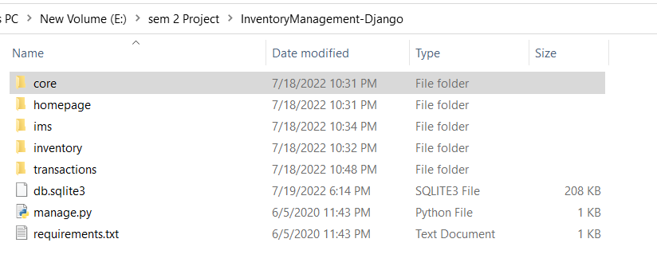
Project Directory

Slide 10
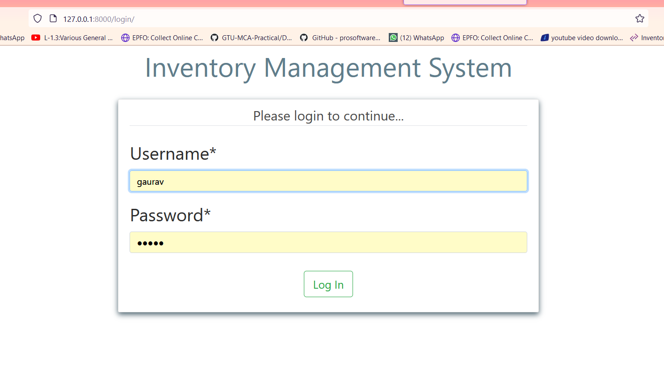
Login Page

Slide 11
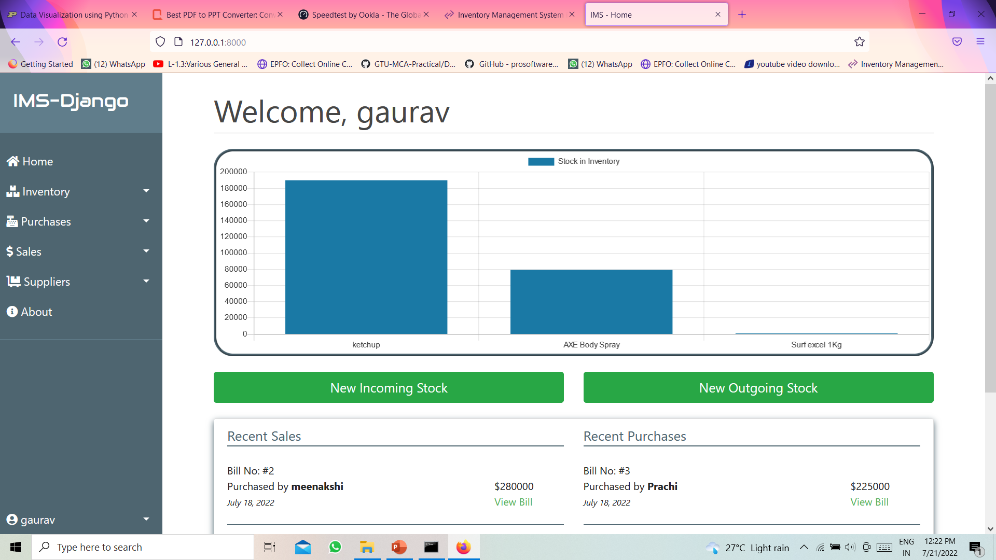
Dashboard

Slide 12
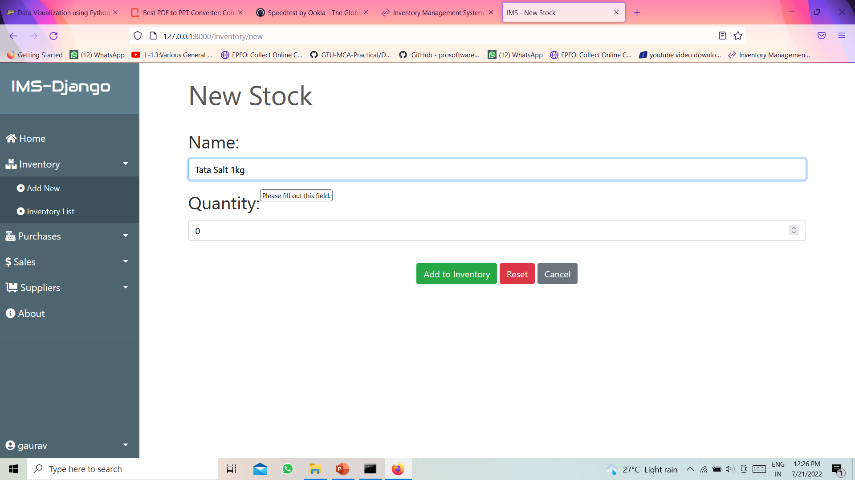
Product Registration

Slide 13
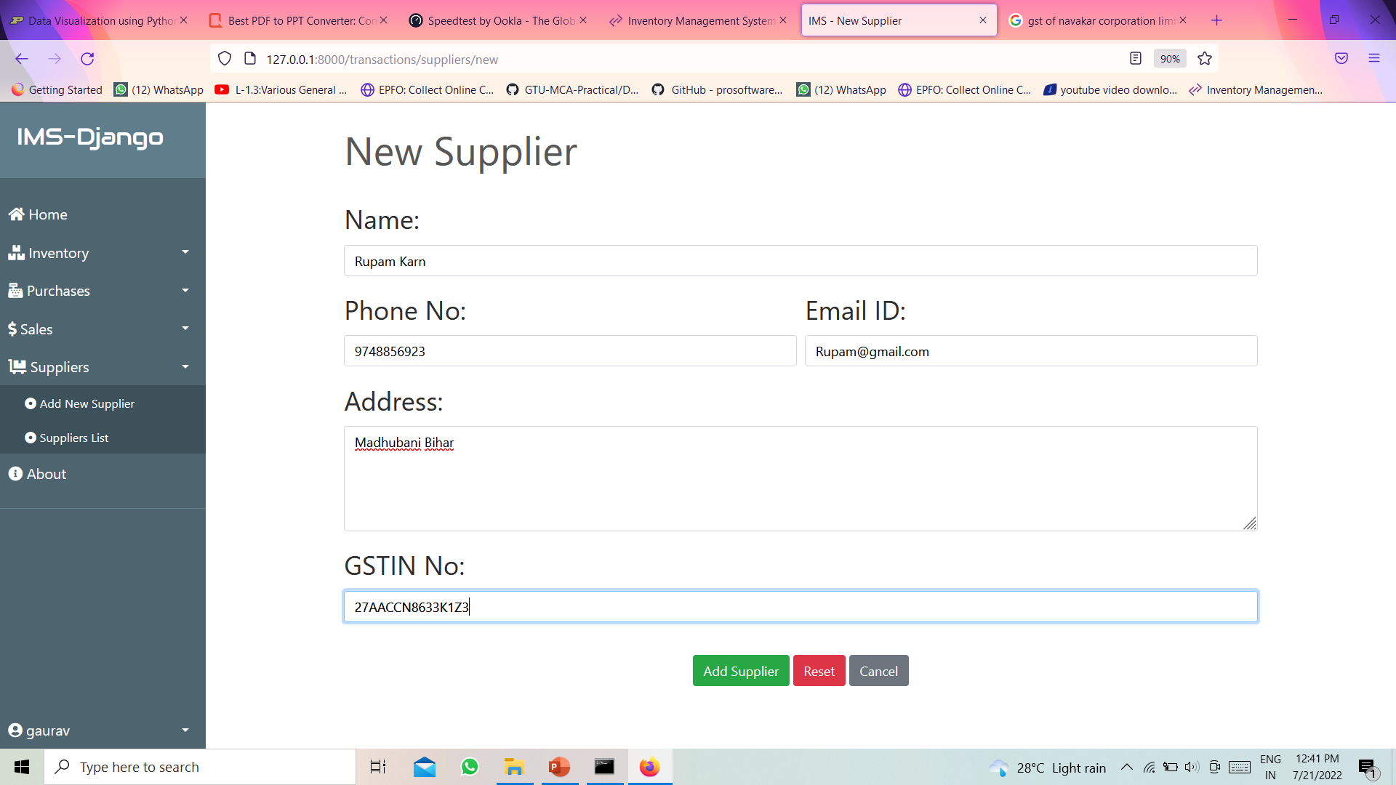
Supplier Registration

Slide 14
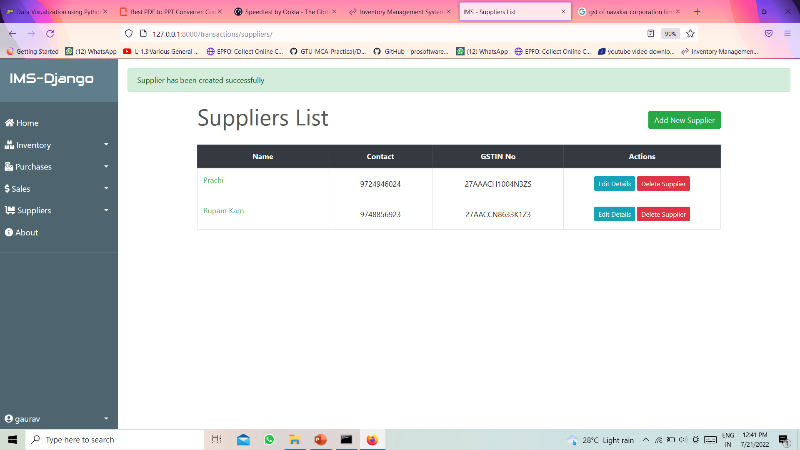
Supplier Registration

Slide 15
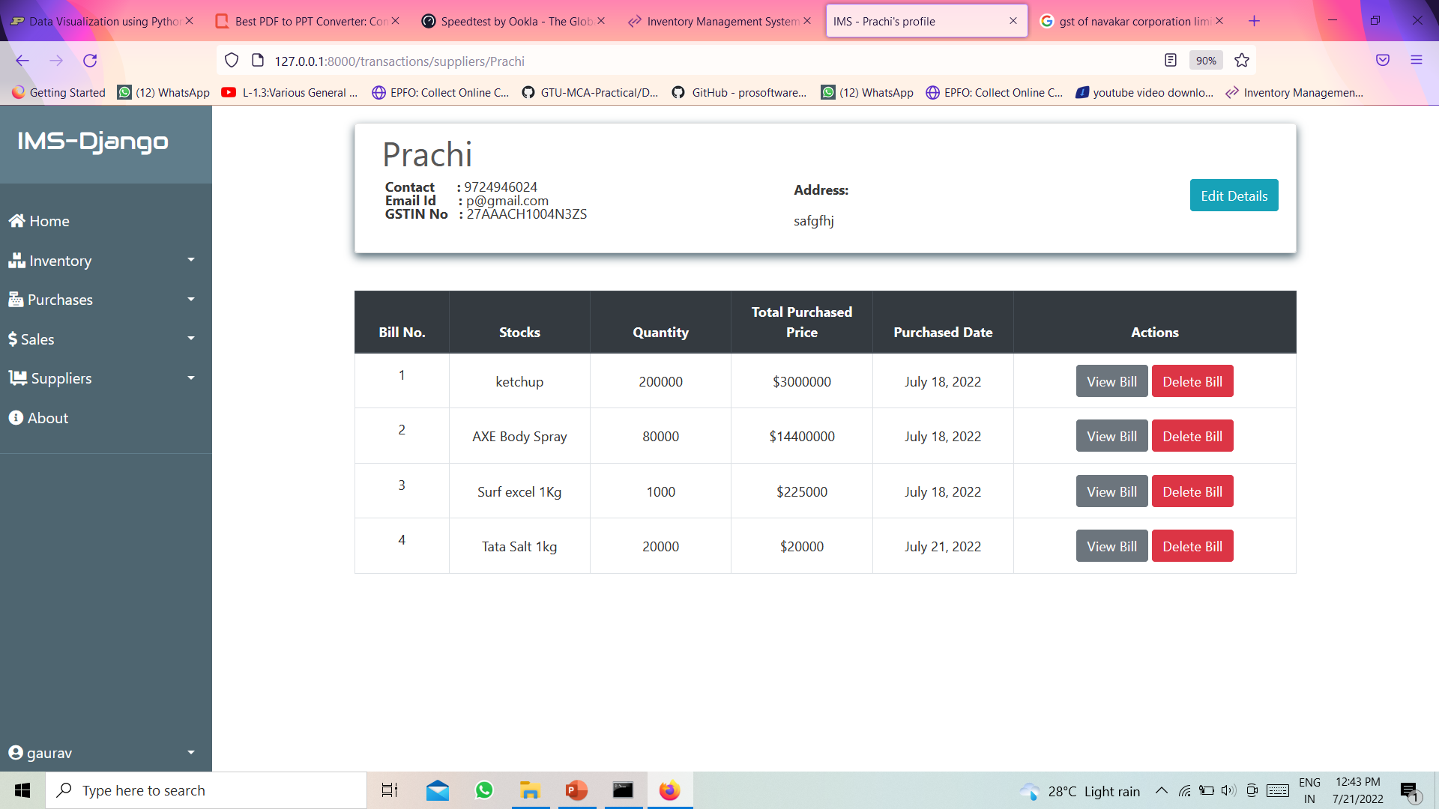
Supplier Profile

Slide 16
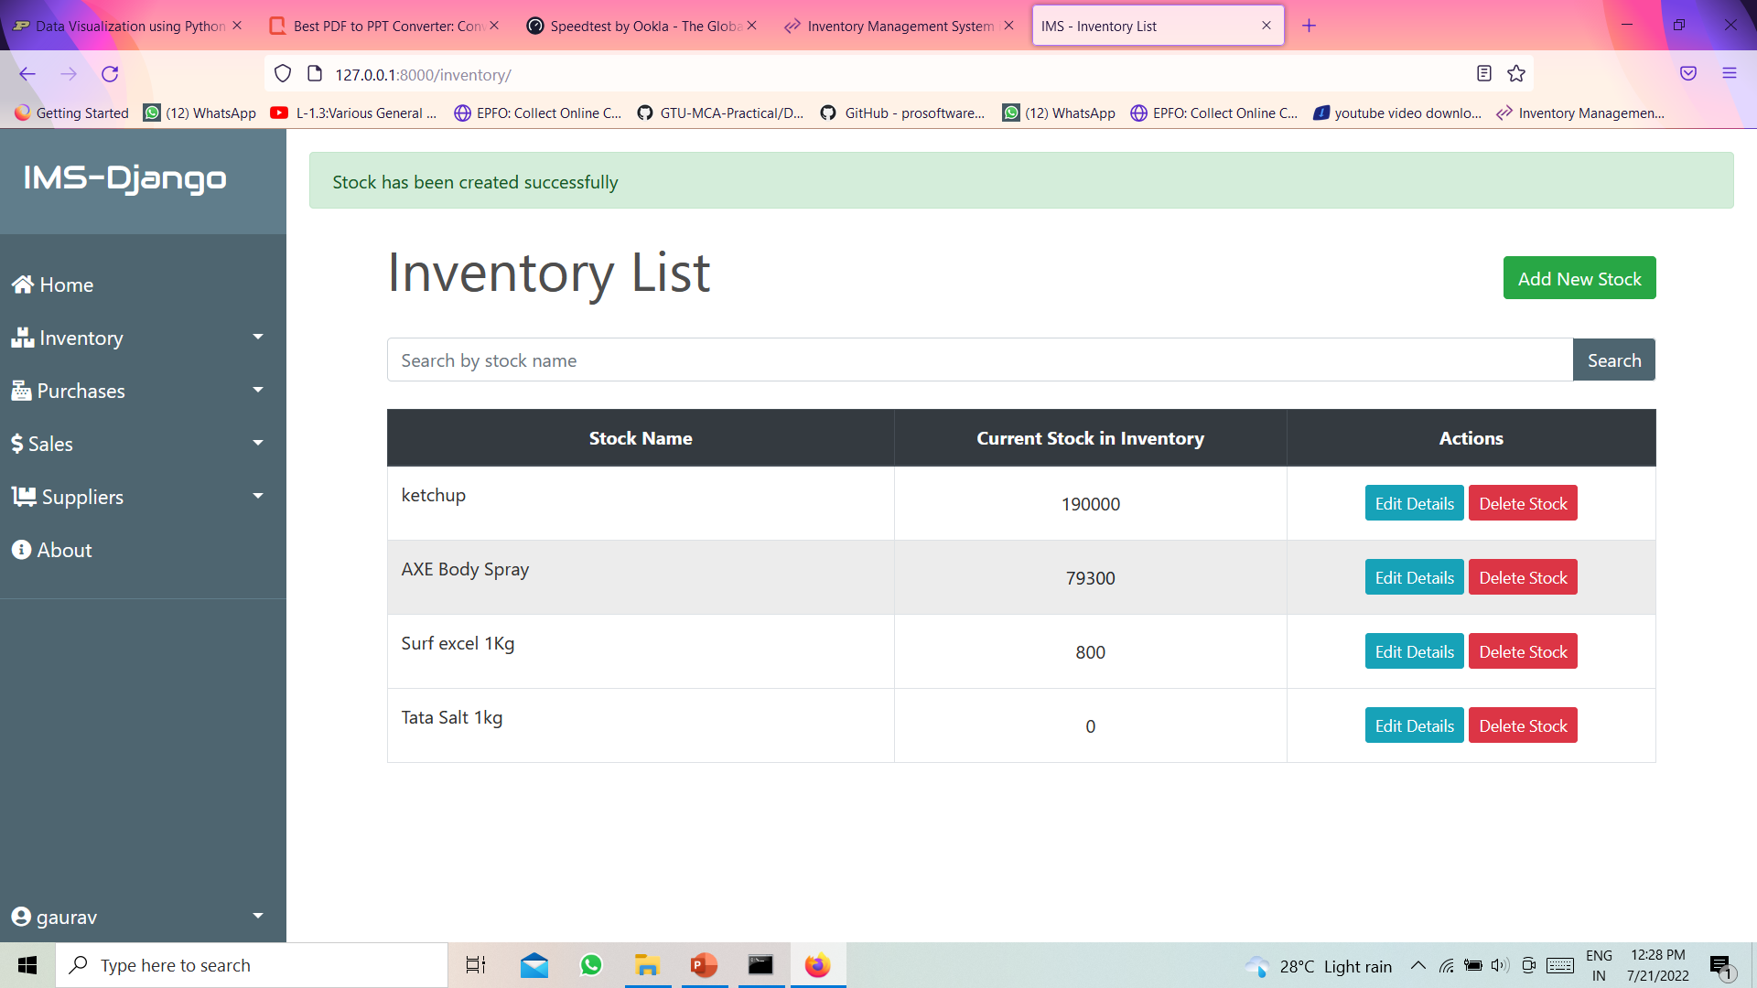
Registered Stock List

Slide 17
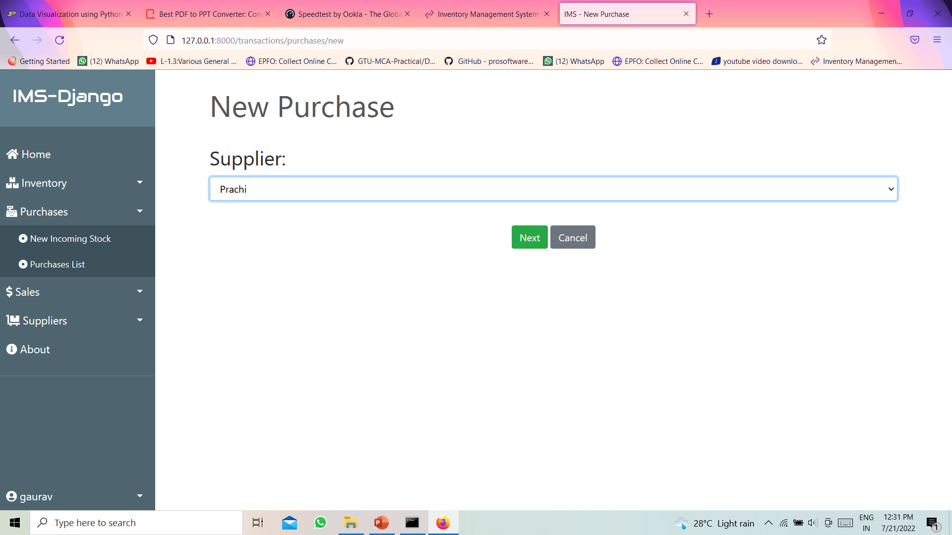
Purchasing Stock From Supplier

Slide 18
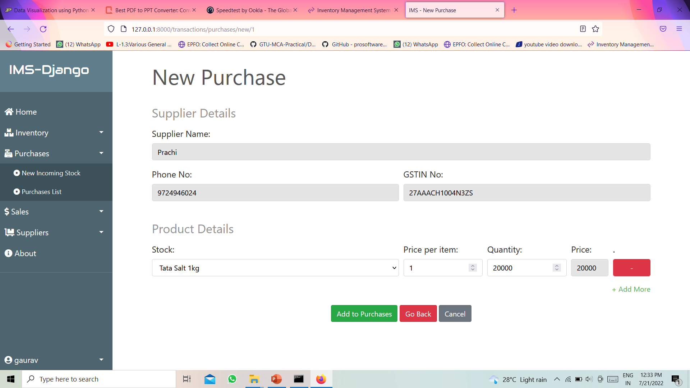
Purchase Cont..

Slide 19
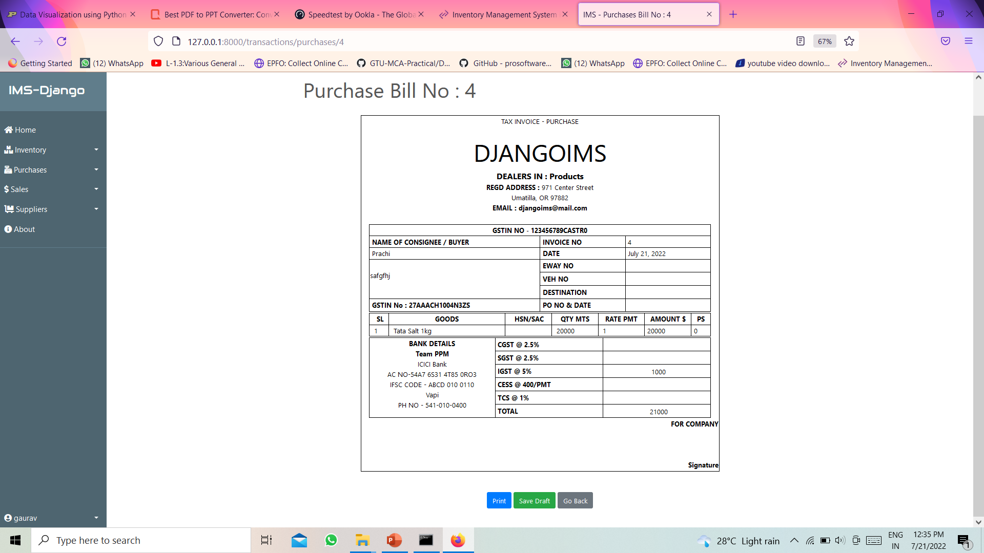
Purchase Bill

Slide 20
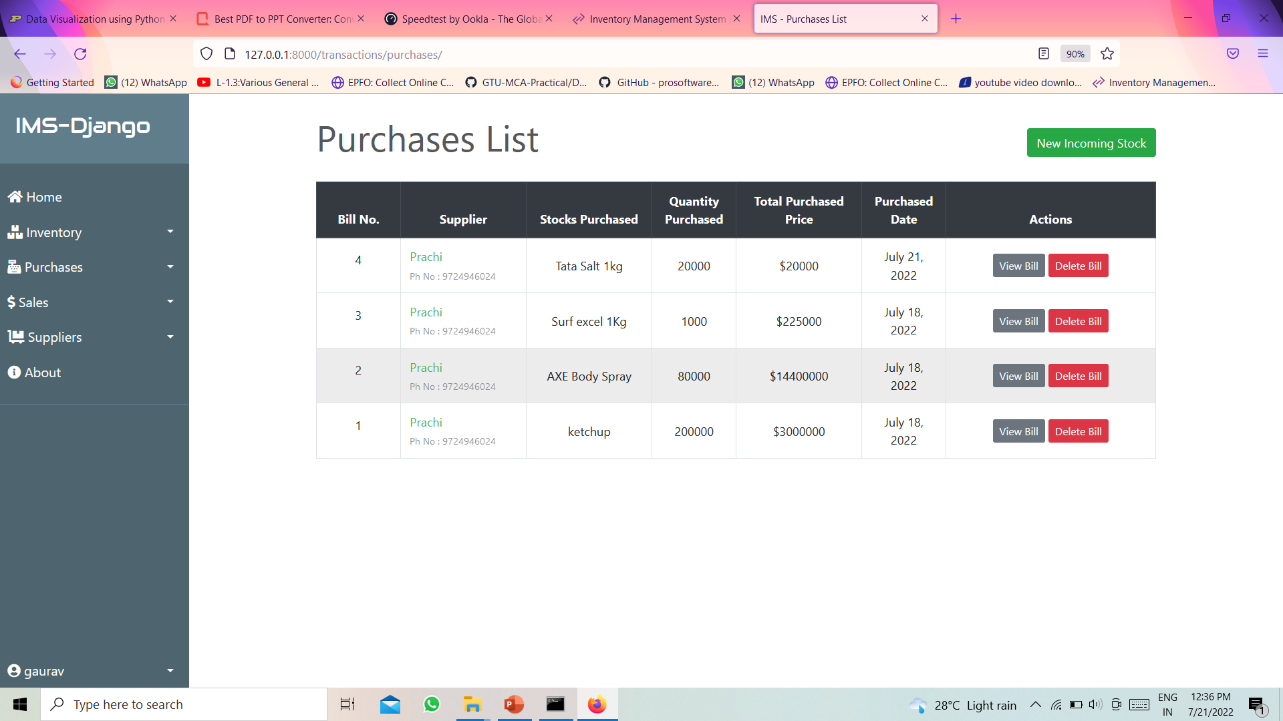
Purchase List

Slide 21
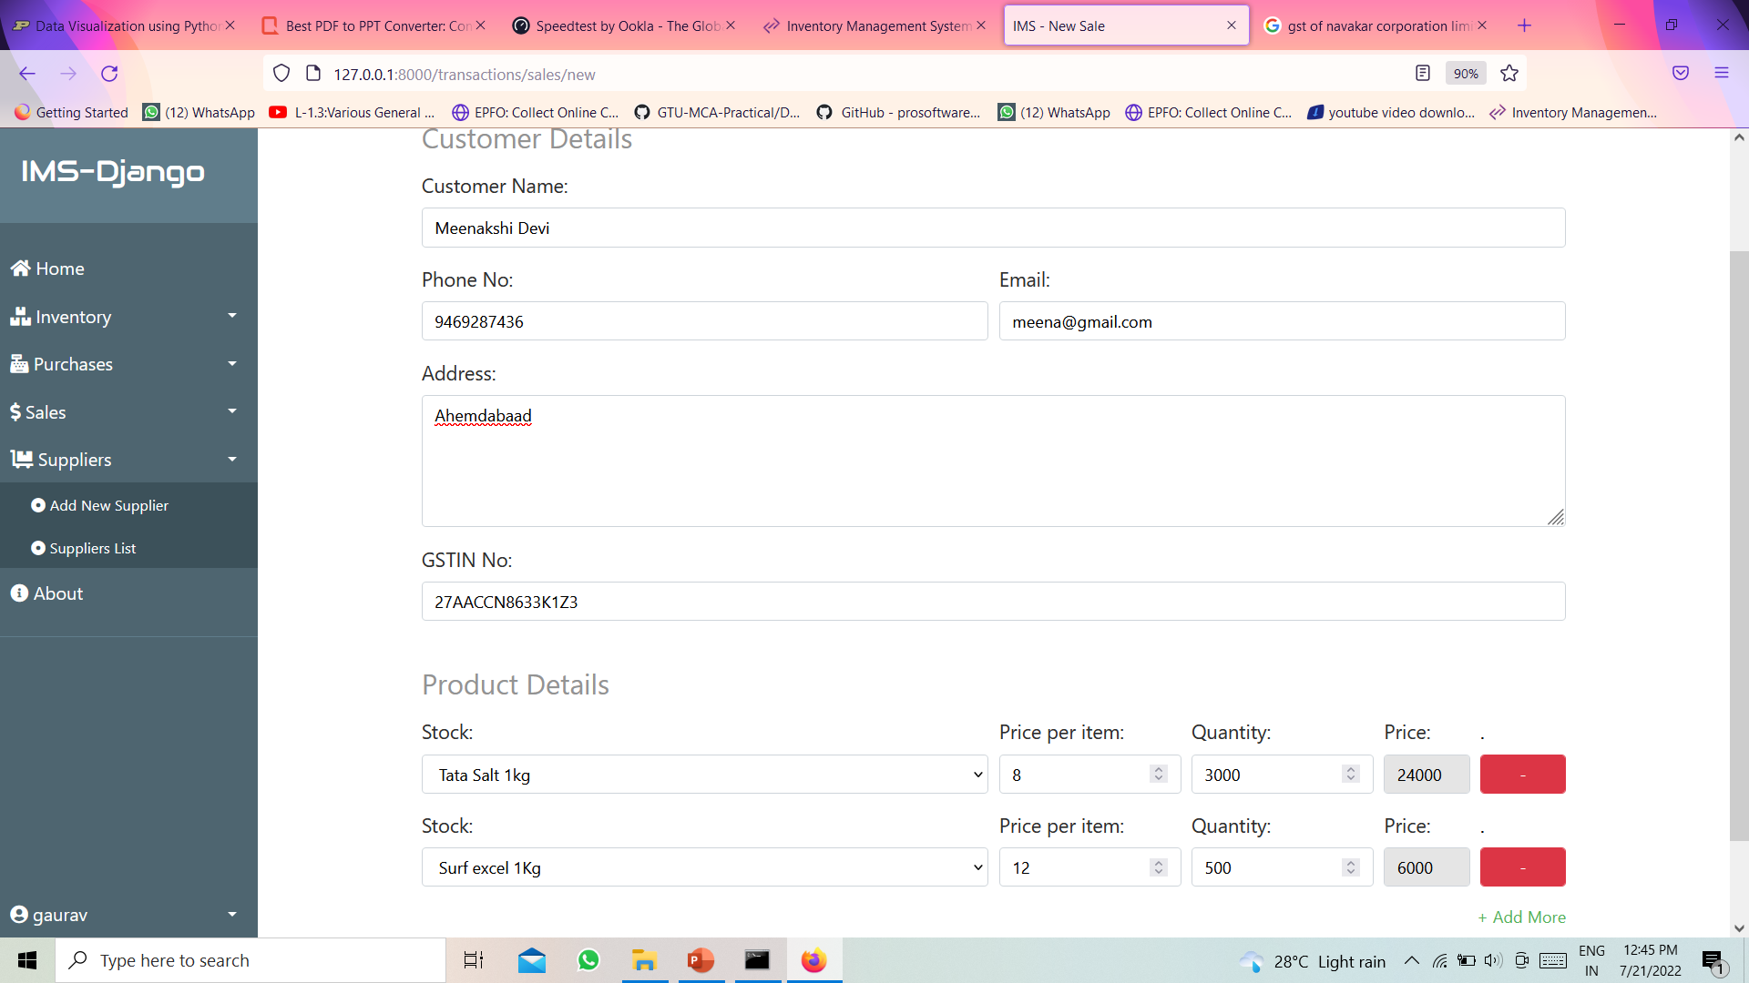
Sales Process

Slide 22
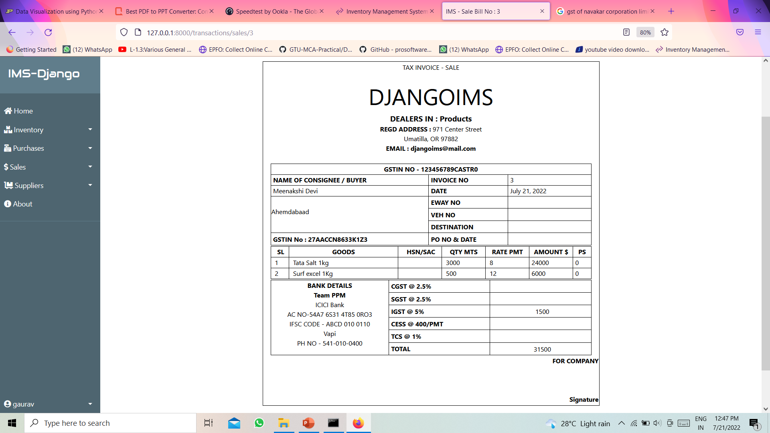
Sales Bill

Slide 23
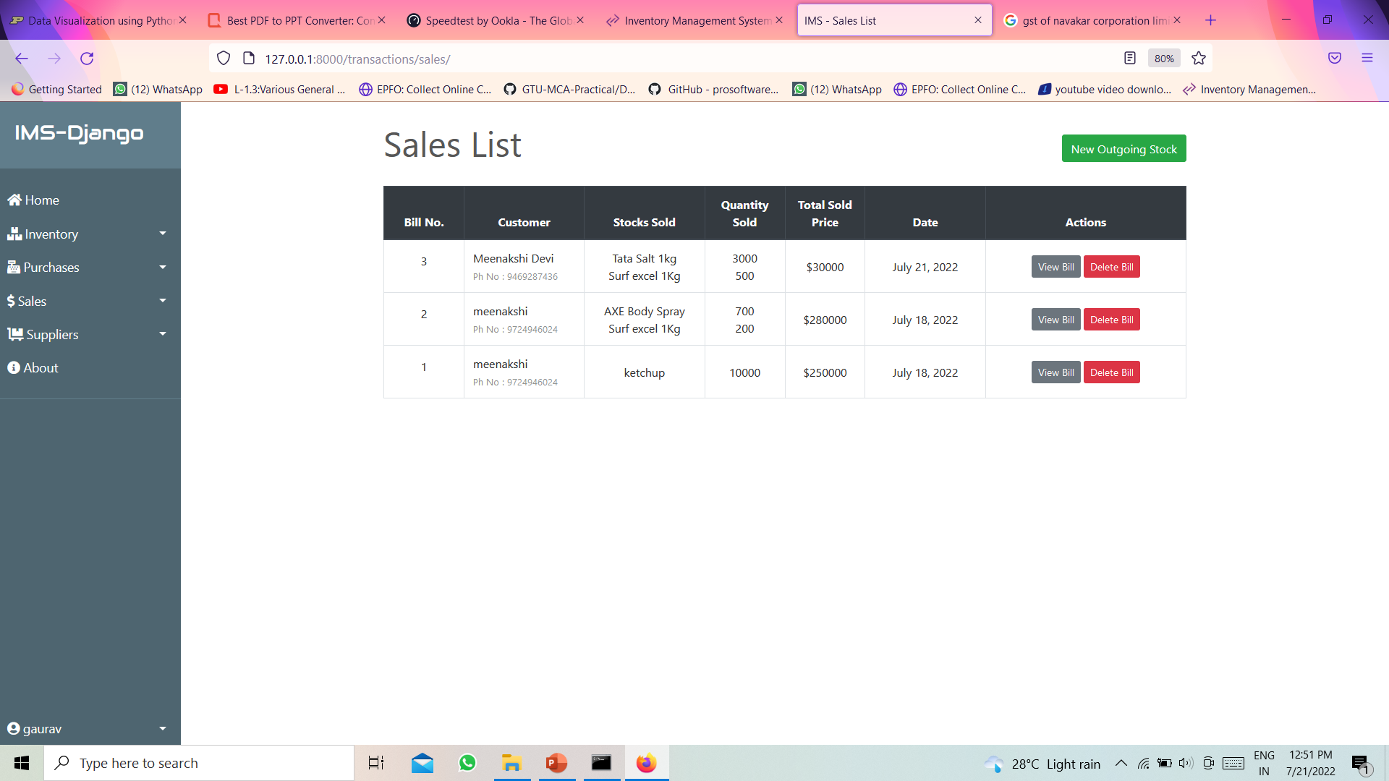
Sales History

Slide 24
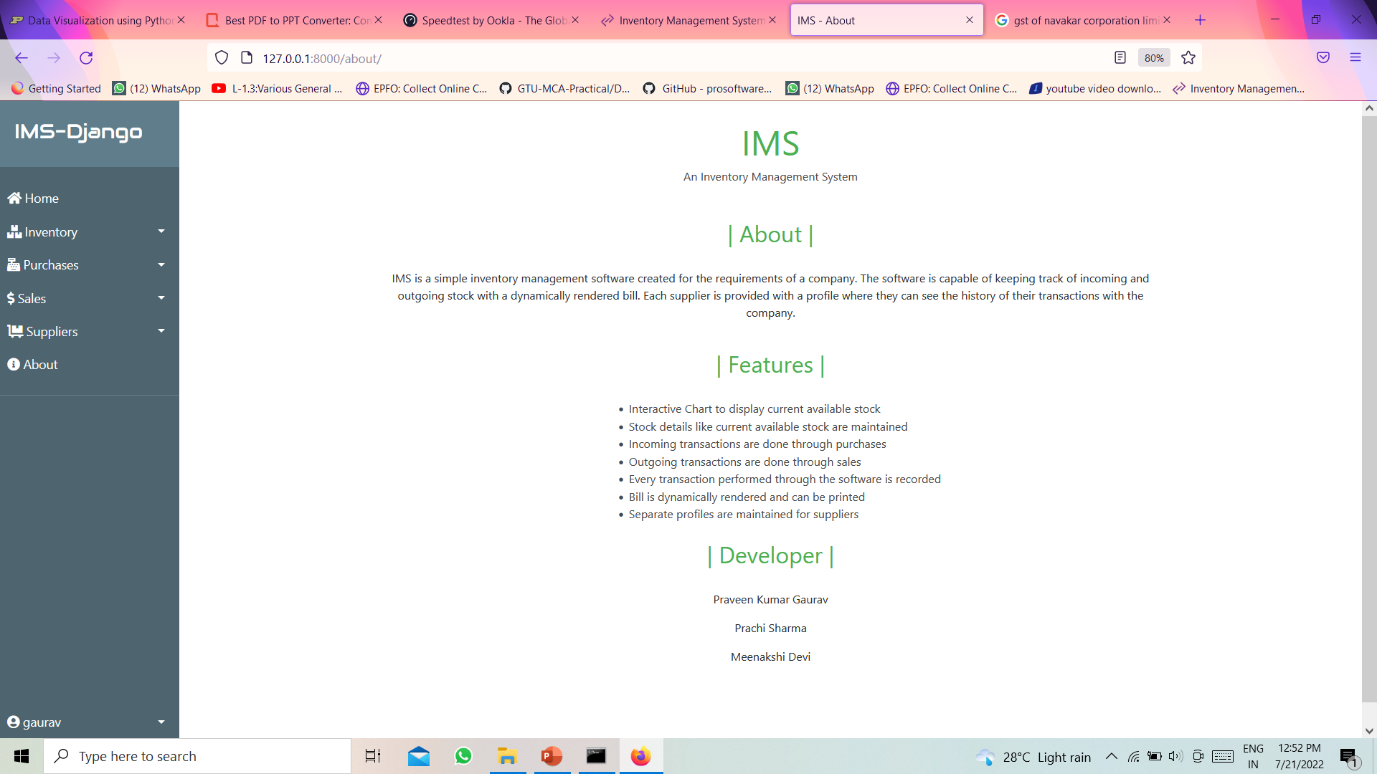
About Us

Slide 25
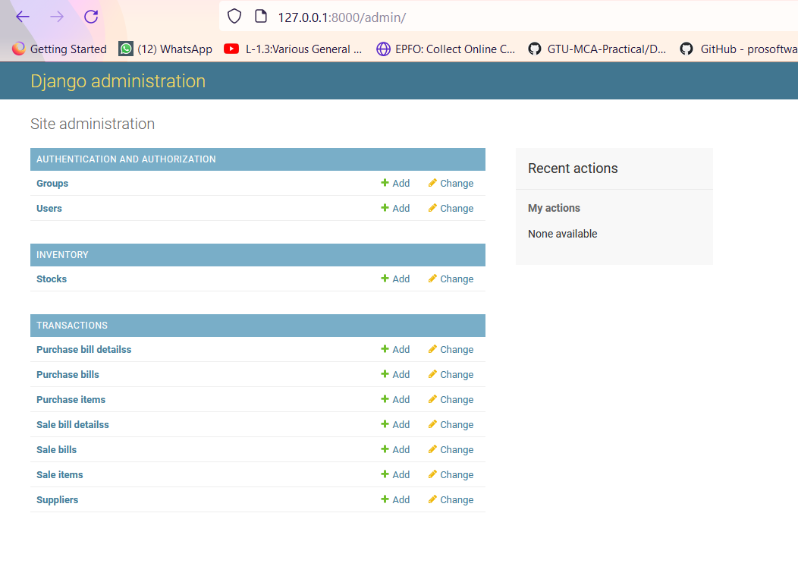
Admin Page

Slide 26
Flow And Module
For Flow Of project We will go with project code

Slide 27
Future Implementation
Revenue Report
Taxation Report
Payment Gateway
Logistics vehicle Management
ERP Implementation

Slide 28
Bibliography
Github.com
Youtube.com
Stackoverflow.com

Slide 29
Thank You

